Slide 1
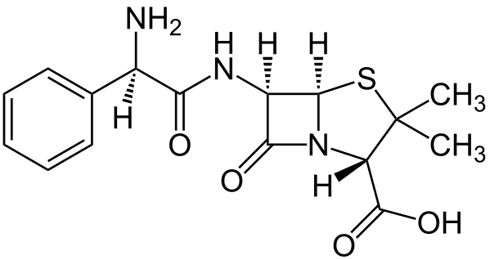
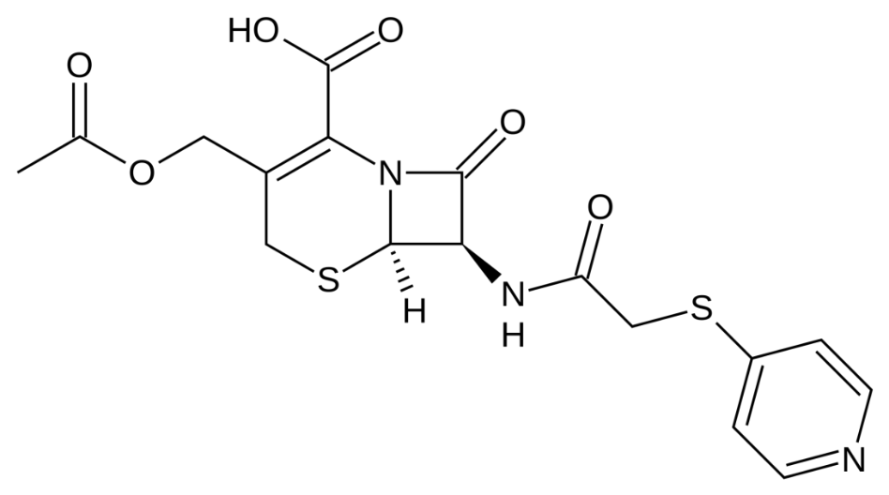
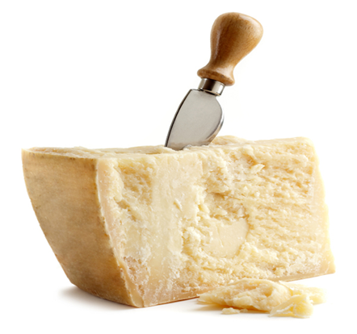
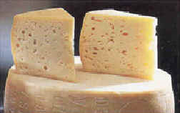
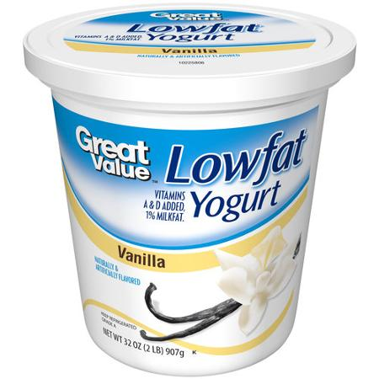
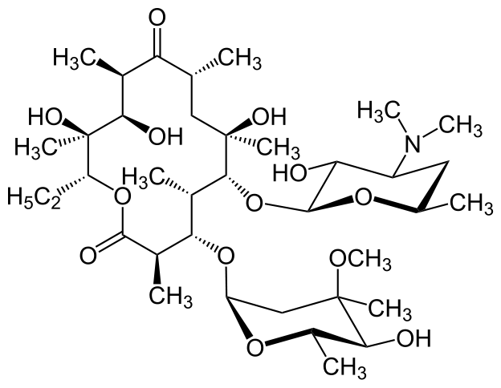
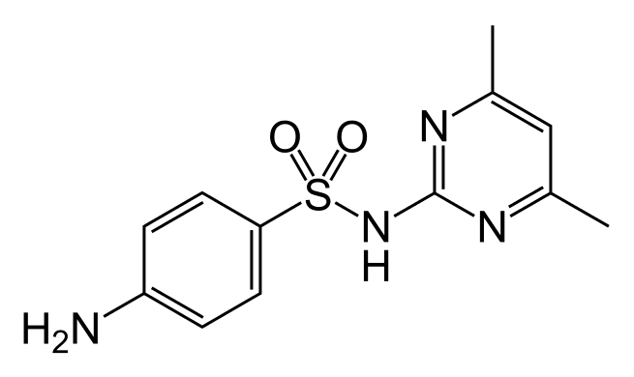
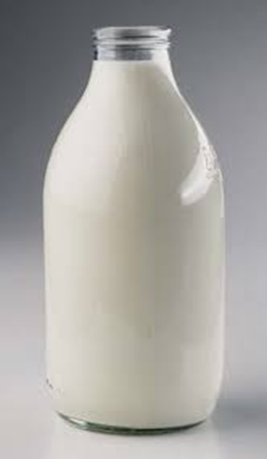
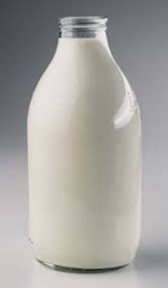
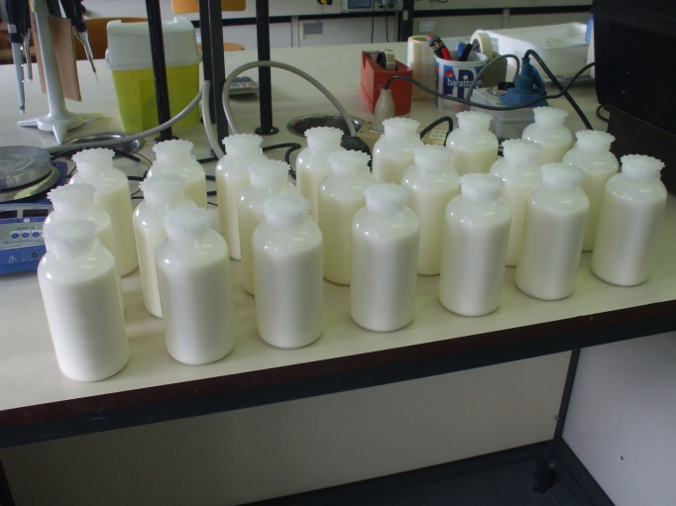
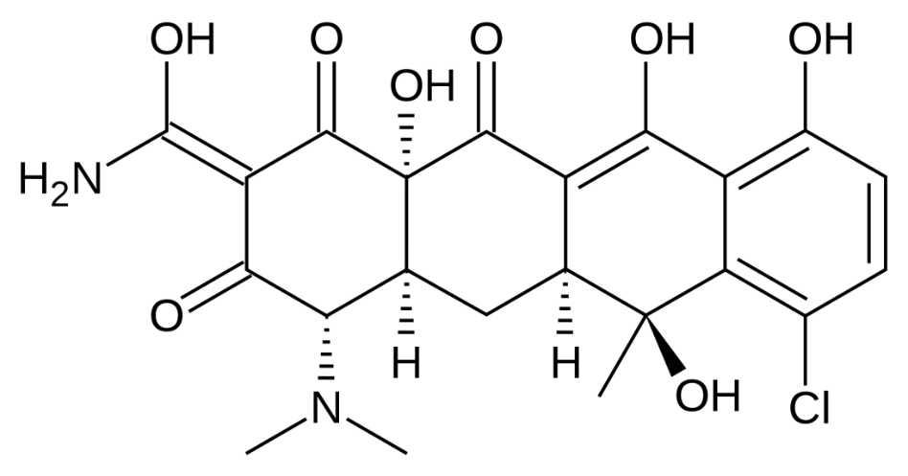
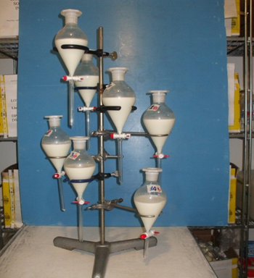
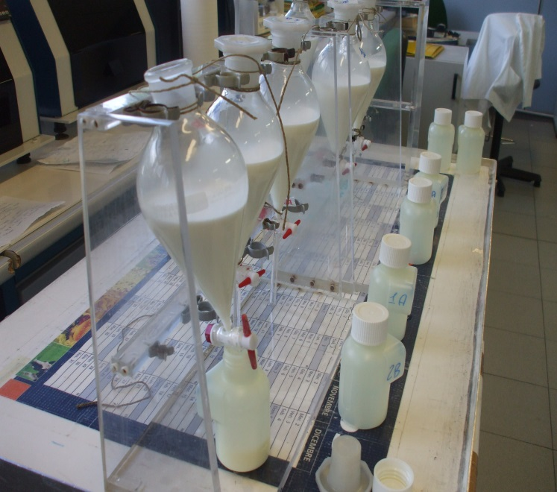
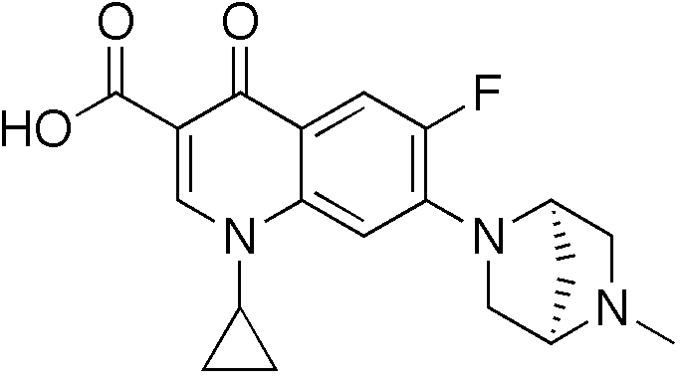
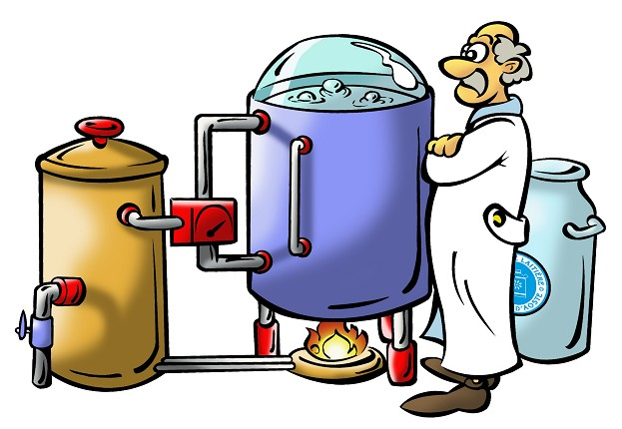
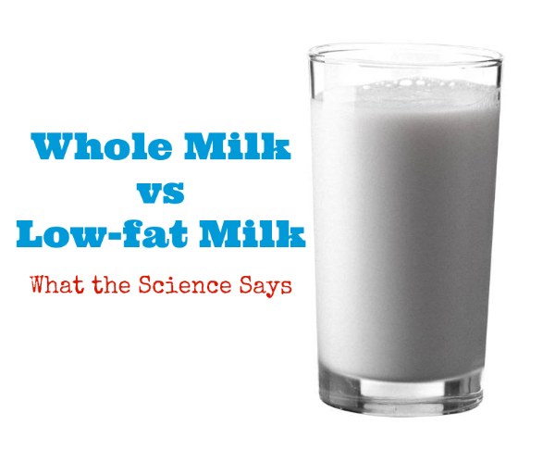
Euroresidue VIII 23-25 May 2016 - Egmond aan Zee, Netherlands
ANTIBIOTIC RESIDUES IN MILK DURING THE CHEESE MAKING PROCESS
PART II. EFFECT OF THE SKIMMING STEP
S. Pellicciotti¹, L. Giannetti², S. Menotta¹, N. Martinelli¹, G. Bolzoni¹ and V. Gamba^{1*}
¹Istituto Zooprofilattico Sperimentale della Lombardia e dell’Emilia Romagna “B. Ubertini”, Brescia, Italy
²Istituto Zooprofilattico Sperimentale del Lazio e della Toscana “M. Aleandri”, Roma, Italy
*email: valentina.gamba@izsler.it
Background
Antibiotics are widely used to treat bacterial infections in lactating cows. In case of insufficient withdrawal periods or increased or incorrect dosage, antibiotic residues will occur in milk.
The European Union has regulated the maximum residue limits (MRLs) allowed in milk (Council Regulation 37/2010/EC) and regulatory authorities have established withdrawal periods that producers have to observe before sending milk from medicated cows to the market. However, this does not guarantee the absence of antibiotic residues in milk, but only that their concentration remains below the MRLs.
Antibiotic residues in raw cheese milk are a public health concern. Moreover, even if below the MRLs, they may potentially interfere with the cheese making process, but very little is known about their persistence in milk and on their potential effects on cheese production.
Skimmed milk is widely used in the diary market of northern Italy and is required for the production of certain types of cheese. To our knowledge, no data is available on the distribution of drug residues between polar and non-polar components of milk, which are separated by the skimming process.
Aim
To determine the distribution of drug residues between polar and non-polar constituents of milk resulting from skimming:
Thirty-two antibiotics belonging to five widely used antibiotic families (β-lactams, macrolides, quinolones, sulfonamides and tetracyclines) were added to milk samples;
Aliquots of milk were skimmed and antibiotic concentration was determined in skimmed and whole milk respectively.
Ampicillin
Cephapirin
Results
Experimental scheme
A
β-LACTAMS
Evaluation of the best skimming conditions in terms of highest cream recovery.
20°C for 6 hour (3.5%)
4°C for 6 hour (15%)
Centrifugation at 3000 rpm
followed by 4°C 10 min (7.5%)
Relative recovery (%)
Erythromycin A
2. Preparation of blank and fortified milk samples.
B
MACROLIDES
C
SULFONAMIDES
β-Lactams,
Tetracyclines,
Macrolides,
Quinolones,
Sulfonamides
Relative recovery (%)
Relative recovery (%)
2 MRL
Sulfamethazine
3. Blank and fortified samples were divided into aliquots.
D
TETRACYCLINES
E
QUINOLONES
Relative recovery (%)
Relative recovery (%)
4. Skimming step: aliquots of blank and fortified milk samples were stored at 4°C for 6 h.
The upper cream layer was removed.
Chlortetracycline
Figure 1. Relative recoveries of β-lactams (A), macrolides (B), sulfonamides (C), tetracyclines (D) and quinolones (E) in spiked milk samples at 2 x MRL after skimming (4°C for 6 h). Values shown are normalized to the results obtained in whole milk (set as 100%).
Fortified milk samples at 2 x MRL were analysed before and after skimming treatment at 4°C for 6 h and relative recoveries of antibiotics in skimmed milk were calculated.
Antibiotic recovery in skimmed milk was higher than 85% for most β-lactams, macrolides, and sulphonamides (with the exception of spiramycin-I, tylosin A and sulfaquinoxaline).
Tetracyclines and quinolones (especially flumequine) were more significantly lost by skimming, but were still recovered with efficiencies ranging from 55% to 80%.
5. Skimmed and not skimmed samples were analysed by specific HPLC-DAD or LC-MS/MS methods for each antibiotic family.
Danofloxacin
Acknowledgements
The authors gratefully acknowledge financial support from the Italian Health Ministry
(Ricerca Corrente IZS LER 2013/002)
Conclusions
The skimming process did not seem to cause a substantial decrease of antibiotic residues in milk. β-lactams and sulphonamides were mainly retained in the aqueous phase of milk while quinolones and tetracyclines showed a higher affinity for the cream layer.
Further work is required to assess the variability of antibiotic recovery efficiencies across independent experiments.
Analysis of antibiotic persistence during the following steps of the cheese making process is currently being carried out.
6. Data analysis.

